Slide 1
Modern Database Systems
BITS Pilani
Prof. Ashish Narang
CSIS

Slide 2
BITS Pilani
<SSZG507, Modern Database Systems> Lecture No. 1

Slide 3
Course Contents
Module 1: Foundations of Structured Data Management
Module 2: Distributed Database Architecture and Consistency Models
Module 3: NoSQL Data Stores
Module 4: Cloud Databases and NewSQL Systems
Module 5: Data Warehouses, Data Lakes and Data Lakehouse
Module 6: Specialized Databases for Modern Applications
Module 7: Emerging Trends in Data Systems

Slide 4
Books
Ramez Elmasri & Shamkant B. Navathe, Fundamentals of Database Systems, 7th Edition, Pearson Education, 2017.
Martin Kleppmann, Designing Data-Intensive Applications: The Big Ideas Behind Reliable, Scalable, and Maintainable Systems, 1st Edition, O'Reilly Media, 2017.
Paulraj Ponniah, Data Warehousing Fundamentals for IT Professionals, 2nd
Edition, John Wiley & Sons, 2010.

Slide 5
Evaluation Components
Evaluation Component | Name | Type | Weightage | Duration | Day, Date, Session, Time
 | (Quiz, Lab, Project, Mid term exam, End semester exam, etc) | (Open book, Closed book, Online, etc.)
EC – 1 | Quiz 1 | Online | 5% | 10-15 minutes | To be announced
 | Quiz 2 | Online | 5% | 10-15 minutes | To be announced
 | Assignment-1 | Take Home | 10% | To be decided | To be announced
 | Assignment-2 | Take Home | 10% | To be decided | To be announced
EC – 2 | Mid Semester Test | Closed Book | 30% | 2 hours | As announced by WILP Exam Team
EC – 3 | Comprehensive Examination | Open book | 40% | 2.5 hours | As announced by WILP Exam Team

Slide 6
Contents
Introduction to Data and Databases
Limitations of Traditional File Systems
Types of Data and Their Characteristics
The Relational Data Model
Data Modelling using ER Diagrams
Basics Database Normalization

Slide 7
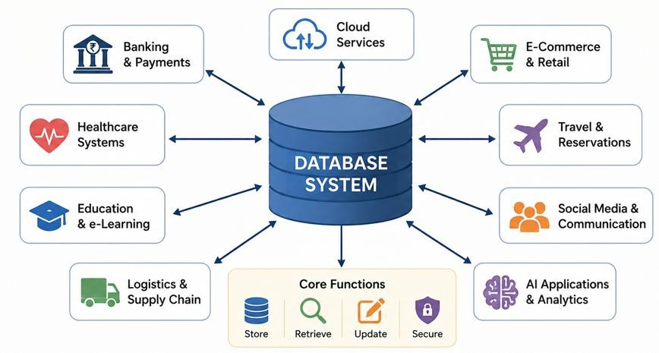
Why Database Systems

Slide 8
Data and Database
Data
Data represents raw facts about people, objects, events, or transactions.
Examples: Student Name, Employee ID, Course Code, Marks, City.
Database
A database is an organized collection of logically related data.
It is designed to efficiently store, retrieve, update, and manage information for a specific application or organization.
Examples: University Database, Banking Database, Hospital Database.

Slide 9
Database Management System (DBMS)
A Database Management System (DBMS) is software that enables users to create, store, organize, manage, and retrieve data efficiently from a database.
A DBMS facilitates:
Defining the database
Specify the database structure, tables, relationships, and constraints.
Constructing the database
Create database objects and populate them with data.
Manipulating the database
Insert, update, delete, and retrieve data.
Support multiple users and applications simultaneously.
Examples: MySQL, PostgreSQL, MongoDB, CockroachDB

Slide 10
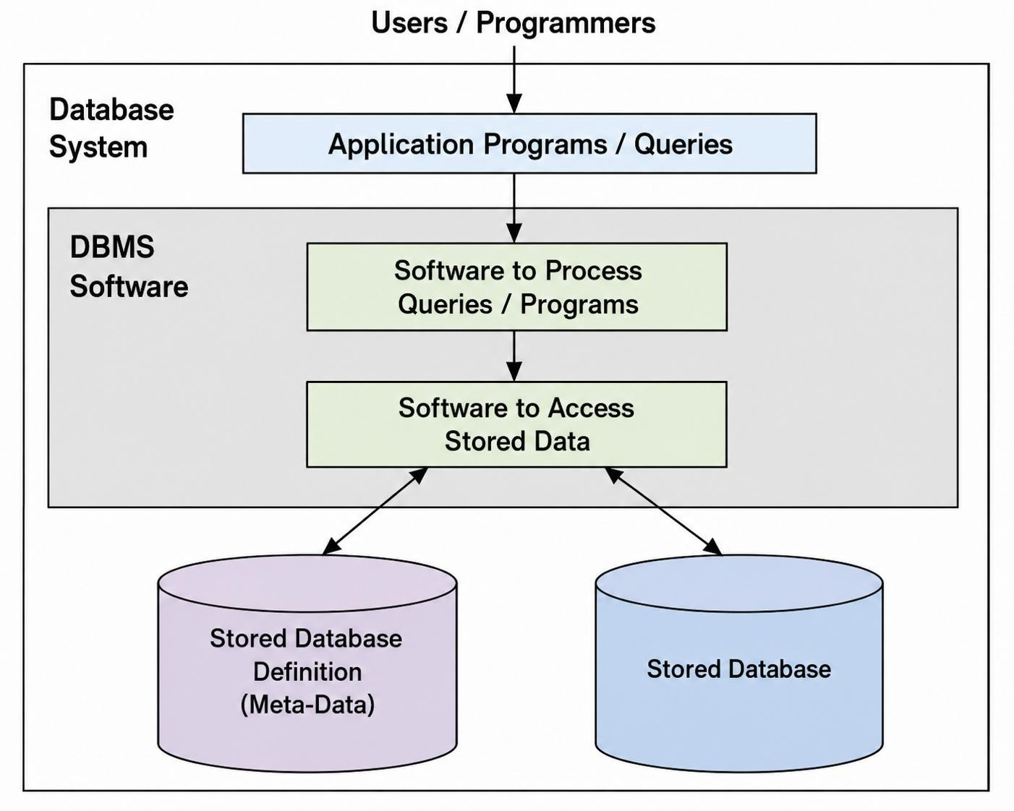
Database System Environment

Slide 11
Traditional File Systems
Before Database Management Systems, Organizations traditionally stored data in separate operating system files.
If we take the example of savings bank enterprise, information about
customers and savings accounts etc. need to be stored.
One way to keep the information on computers is to store in the files provided by operating systems (OS).
Example: A Banking System Customer records → customers.txt Account details → accounts.txt Transactions → transactions.txt Loans → loans.txt

Slide 12
Challenges with File Based Storage
Data Redundancy – The same data may be stored in multiple files, leading to unnecessary duplication.
Data Inconsistency – Updates made in one file may not be reflected in others. Difficult Data Access – Retrieving information often requires writing or modifying application programs.
Limited Data Sharing – Data stored in separate files is difficult to share across applications.
Poor Security – File systems provide only basic access control mechanisms.
No Centralized Backup and Recovery – Recovering data after failures is difficult and time-consuming.
Integrity Constraints are Difficult to Enforce – Ensuring valid and consistent data across files is challenging.

Slide 13
Advantages of DBMS Approach
Controlled Data Redundancy – Minimizes duplicate data, reducing storage requirements
and improving data consistency.
Efficient Data Access – Enables fast retrieval, insertion, updating, and deletion of data using query languages.
Data Integrity – Ensures data accuracy and consistency by enforcing integrity constraints.
Enhanced Security – Provides authentication, authorization, and access control to protect sensitive information.
Concurrency Control – Allows multiple users to access and modify the database simultaneously while maintaining consistency.
Backup and Recovery – Protects data from hardware or software failures through backup
and recovery mechanisms.
Reduced Application Development Time – Provides built-in services such as data management, security, and transaction processing, reducing development effort.

Slide 14
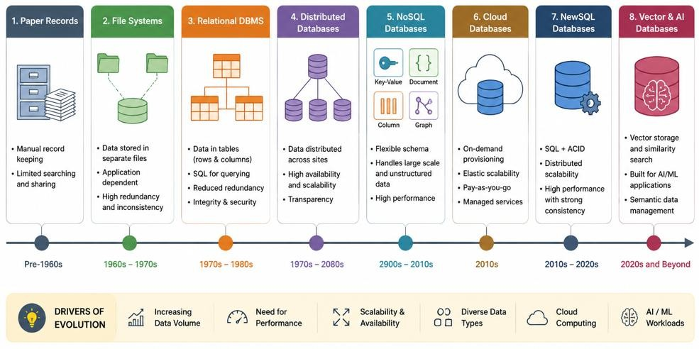
Evolution of Databases

Slide 15
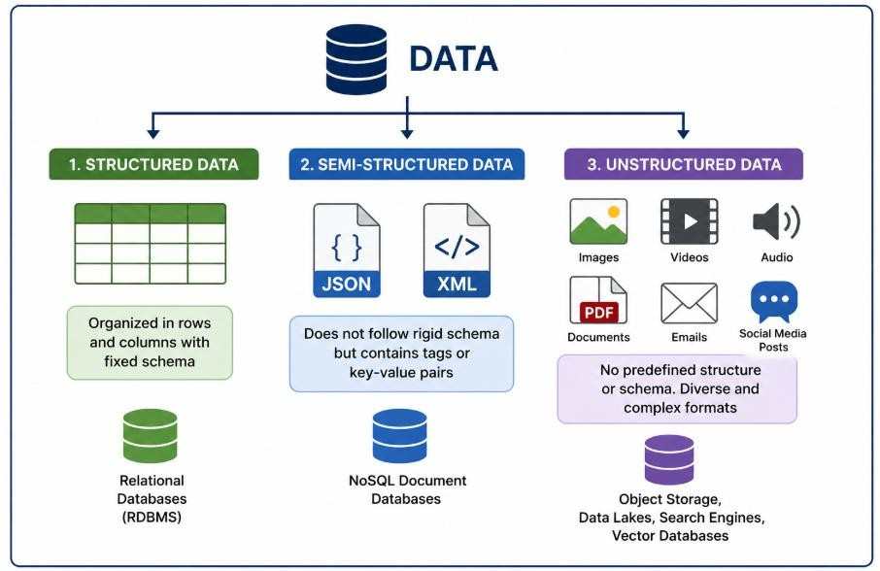
Types of Data
Data can be classified based on how it is organized and represented. Different types of data require different storage and management techniques.
Structured Data
Semi-Structured Data
Unstructured Data

Slide 16
Structured Data
Structured data is data that is organized according to a predefined schema, making it easy to store, retrieve, and process.
Characteristics
Organized into rows and columns
Follows a fixed schema
Each attribute has a defined data type
Easily queried using SQL
Ensures consistency and integrity
Student_id | Name | Age
A120 | Raju | 21
A134 | Kiran | 19
C110 | John | 22

Slide 17
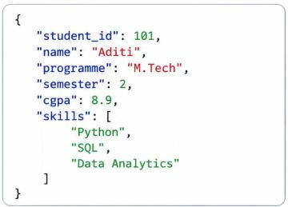
Semi-Structured Data
Semi-structured data does not follow a rigid tabular schema but contains tags, keys, or metadata that provide structure and organization.
Characteristics
Does not follow a fixed schema
Self-describing using tags or key–value pairs
Flexible and easily extensible
Suitable for exchanging and integrating data
Commonly stored in JSON, XML, and YAML formats

Slide 18
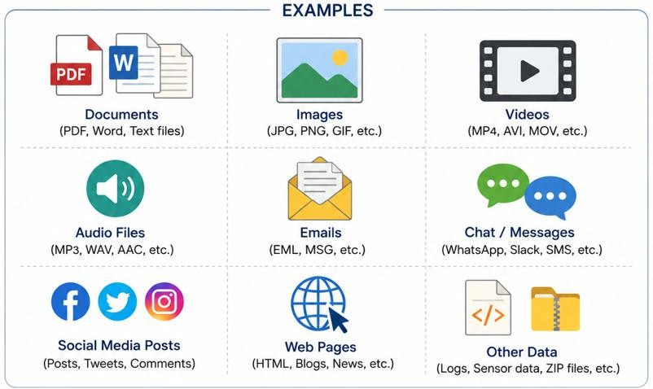
Unstructured Data
Unstructured data is information that does not follow a predefined schema or organized format, making it difficult to store and analyze using traditional relational databases.
Characteristics
No predefined schema or fixed structure
Contains text, images, audio, video, and documents
Difficult to query using traditional SQL
Requires specialized storage and processing techniques
Forms the majority of data generated today
Examples include documents, images,
photographs, Audio Files, Video Files

Slide 19
Structured vs Semi-Structured vs Unstructured
Feature | Structured | Semi-Structured | Unstructured
Schema | Fixed | Flexible | No Fixed Schema
Storage | Tables | JSON, XML | Files, Objects
Query | SQL | JSONPath, XPath | AI/Search Engines
Examples | Student Records | API Responses | Images, Videos, PDFs
Databases | MySQL, PostgreSQL | MongoDB | Object Storage, Elasticsearch, Vector Databases

Slide 20
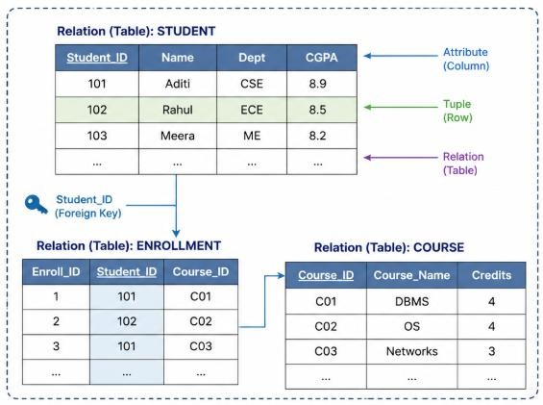
Relational Model
The Relational Model organizes data into tables (relations) and represents relationships among data using keys.
Key Characteristics
Represents data as relations (tables).
Each relation consists of rows (tuples) and columns (attributes).
Each relation has a unique name.
Relationships between relations are
established using keys.
Supports high
data integrity through
constraints.
Uses SQL for
manipulation.
data definition and

Slide 21
Relational Model Constraints
A relational database typically consists of multiple related tables containing interrelated
data.
To ensure the accuracy, consistency, and validity of the data, the relational model defines a set of constraints.
These constraints help maintain data integrity and prevent invalid or inconsistent data
from being stored in the database.
Relational model constraints can be broadly classified into:
Schema-Based Constraints
Domain Constraints
Key Constraints
Entity Integrity Constraints
Referential Integrity Constraints
Application-Based (Semantic) Constraints

Slide 22
Domain Constraint
A domain constraint specifies that the value of each attribute in a tuple must belong to its defined domain.
A domain defines the set of permissible values for an attribute, including its data type, range, format, and other restrictions.
Common domains include:
Integer
Real Number
Character/String
Boolean
Date
Time
Attribute | Domain | Valid Values
Age | Integer | 18–60
CGPA | Decimal | 0.0–10.0
Gender | CHAR(1) | M, F
Join_Date | DATE | Valid dates only

Slide 23
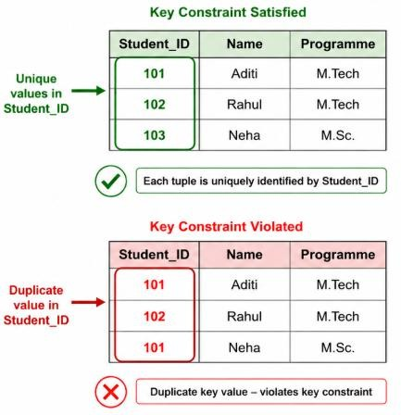
Key Constraints
A key is one or more attributes that uniquely identify each tuple (row) in a relation.
A key constraint ensures that no two tuples in a relation have the same key value.
Every relation must contain at least one attribute or combination of attributes that uniquely identifies each tuple.
Key constraints introduce the following types of keys:
Super Key
Candidate Key
Primary Key

Slide 24

Super Key
A Super Key is a set of one or more attributes that uniquely identifies each tuple (row) in a relation.
Characteristics
Uniquely identifies every tuple in a relation.
May contain additional (redundant) attributes.
A relation can have multiple super keys.
Student_ID | Email | Name | Programme
101 | aditi@bits.edu | Aditi | M.Tech
102 | rahul@bits.edu | Rahul | M.Tech
Some of the Possible Super Keys:
{Student_ID}
{Email}
{Student_ID, Name}
{Student_ID, Programme}
{Email, Name}

Slide 25

Candidate Key
A Candidate Key is a minimal Super Key that uniquely identifies each tuple in a relation.
Characteristics
Student_ID | Email | Name | Programme
101 | aditi@bits.edu | Aditi | M.Tech
102 | rahul@bits.edu | Rahul | M.Tech
Uniquely identifies each tuple in a relation.
Contains no redundant attributes.
Every relation has at least one Candidate Key.
One of the Candidate Keys is selected as the
Primary Key.
Candidate Keys:
{Student_ID}
{Email}

Slide 26

Primary Key
A Primary Key is the Candidate Key selected to uniquely identify each tuple (row) in a relation. Characteristics
Student_ID | Email | Name | Programme
101 | aditi@bits.edu | Aditi | M.Tech
102 | rahul@bits.edu | Rahul | M.Tech
Candidate Keys:
{Student_ID}
{Email}
Chosen from the set of Candidate Keys.
Must contain unique values.
Cannot contain NULL values.
Only one Primary Key can be defined for a relation.
Primary Key:
{Student_ID}

Slide 27
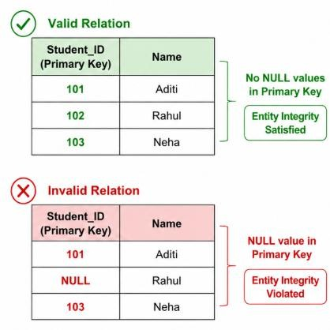
Entity Integrity Constraint
The Entity Integrity Constraint states that the Primary Key of a relation cannot contain NULL values.
Since the Primary Key uniquely identifies each tuple (row) in a relation, every record must have a valid Primary Key value.
Allowing NULL values in the Primary Key would make it impossible to uniquely identify a tuple.

Slide 28
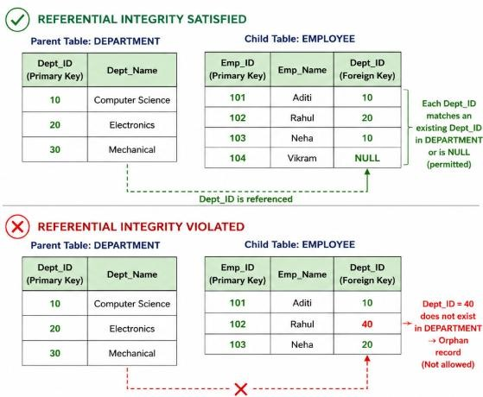
Referential Integrity Constraint
Ensures that every foreign key value in a relation either:
matches an existing primary key value in the referenced relation, or
is NULL (if permitted).
Prevents the creation of orphan records and
maintains consistency between related tables.
Ensures that relationships between tables remain valid and consistent

Slide 29
Other Types of Constraints
Salary of employee should not exceed the salary of Employees supervisor.
Maximum number of hours an employee can work on a project per week is 56 hours.
Salary of employee should increase only.
These constraints can be enforced through application programs.

Slide 30
Data Modelling
Before creating database tables, we first need to understand the real-world objects, their properties, and the relationships among them. This process is called Data Modelling.
Why Data Modelling?
Represents real-world requirements in a structured manner.
Simplifies database design.
Reduces redundancy and improves consistency.
Serves as the foundation for database implementation.

Slide 31
Entity-Relationship (ER) Modelling
Entity-Relationship (ER) Modelling is a conceptual data modelling technique used to represent the structure of a database before implementation.
ER Model Represents
Entities – Real-world objects about which data is stored.
Attributes – Properties that describe an entity.
Relationships – Associations between entities.
Why ER Modelling?
Provides a visual representation of the database.
Simplifies database design and communication.
Helps identify entities, attributes, and relationships.
Serves as the blueprint for designing relational databases.

Slide 32
Entity-Relationship (ER) Model
The Entity-Relationship (ER) Model is a conceptual data modelling technique used to represent the data requirements of an organization before database implementation.
The ER Model is represented using an Entity-Relationship Diagram (ER Diagram), which graphically depicts:
Entities – Real-world objects about which data is stored.
Attributes – Properties that describe an entity.
Relationships – Associations among entities.

Slide 33
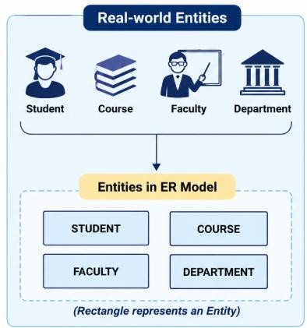
Entity
An entity is a real-world object, person, place, event, or concept that can be uniquely identified and about which data is stored. Each entity represents a distinguishable object in the real world.
Examples of entities include:
Student
Course
Faculty
Department
Employee

Slide 34
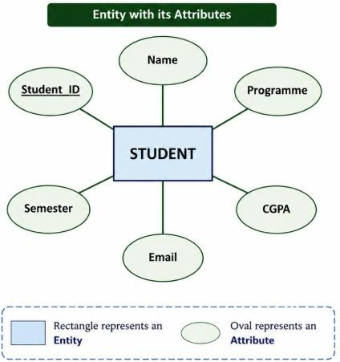
Attributes
Attributes are the properties or characteristics that describe an entity.
Each entity is described by one or more attributes.
Every entity instance has a value for each of its
attributes.
Example
Entity: Student
Attributes:
Student_ID
Name
Programme
Semester
CGPA
Email

Slide 35
Attribute Types
Based on their characteristics, attributes in an ER model can be classified into the following types:
Simple Attribute – Cannot be divided into smaller components.
Composite Attribute – Can be divided into smaller meaningful components.
Single-Valued Attribute – Holds only one value for an entity.
Multi-Valued Attribute – Can hold multiple values for an entity.
Derived Attribute – Value is computed from one or more other attributes.

Slide 36
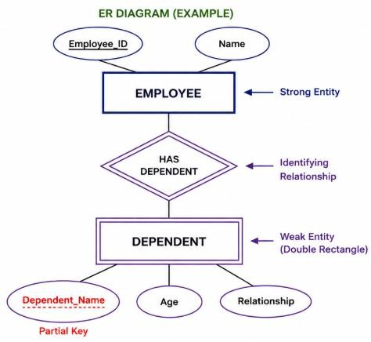
Weak Entity
A Weak Entity is an entity that cannot be uniquely identified by its own attributes.
Its existence depends on another entity, called the Owner (or Identifying) Entity.
A Weak Entity is identified using:
The Primary Key of the Owner Entity, and
Its own Partial Key.
Example
Employee → Dependent
An employee can exist independently.
A dependent cannot exist without an employee.

Slide 37
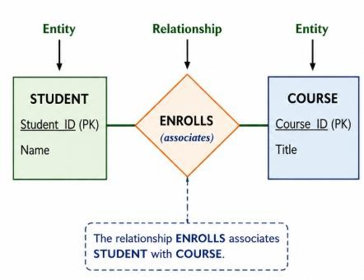
Relationship
A relationship represents an association between two or more entities.
It describes how entities are connected and interact with each other.
Examples
A Student enrolls in a Course.
A Faculty teaches a Course.
A Department offers a Programme.

Slide 38
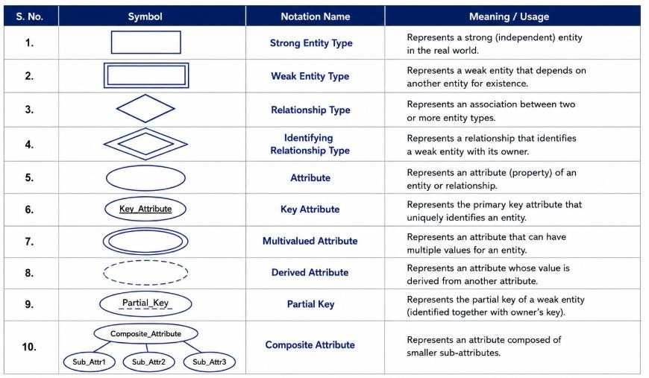
Notations Used in ER diagrams

Slide 39
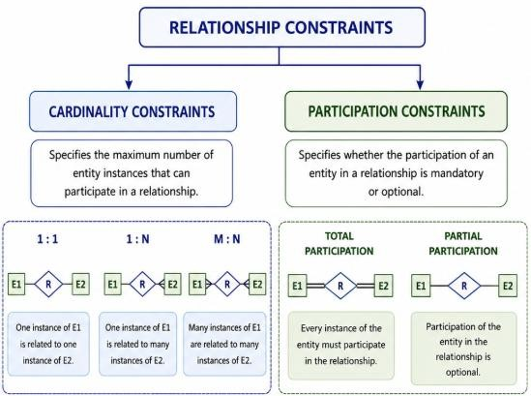
Relationship Constraints
Relationship participate in
constraints
specify how entities
a relationship and define the
nature of associations between entities.
Two types of relationship constraints:
Cardinality Constraints
Specify the maximum number of entity instances that can participate in a relationship.
Examples: 1:1, 1:N, M:N
Participation Constraints
Specify whether the participation of an entity in a relationship is mandatory or optional.
Types: Total Participation and Partial Participation

Slide 40
Exercise
The COMPANY database keeps track of a company’s employees, departments, and projects. Suppose that after the requirements collection and analysis phase, the database designers provide the following description of the miniworld—the part of the company that will be represented in the database.
The company is organized into departments. Each department has a unique name, a unique number, and a particular employee who manages the department. We keep track of the start date when that employee began managing the department. A department may have several locations.

Slide 41
Contd..
A department controls a number of projects, each of which has a unique name, a unique number, and a single location.
We store each employee’s name, Social Security number, address, salary, gender, and birth date. An employee is assigned to one department, but may work on several projects, which are not
necessarily controlled by the same department. We keep track of the number of hours per week that an employee works on each project. We also keep track of the direct supervisor of each employee (who is another employee).
We want to keep track of the dependents of each employee for insurance purposes. We keep each dependent’s first name, gender, birth date, and relationship to the employee.

Slide 42
Identify the Entities
Employee
Department
Project
Dependent

Slide 43
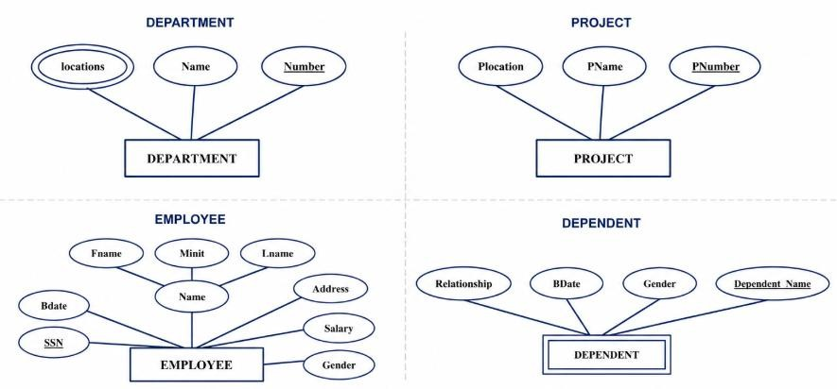
Contd..

Slide 44
Relationships
Employee manages Department
Employee works for Department
Department controls project
Employee supervises Employee
Employee works on projects
Employee has Dependents

Slide 45
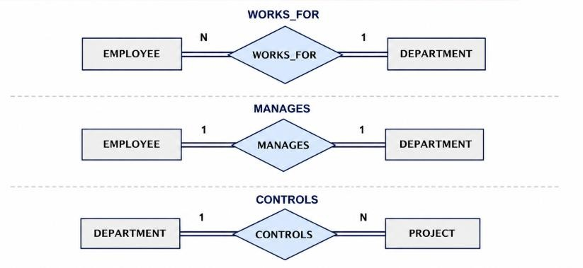
Contd..

Slide 46
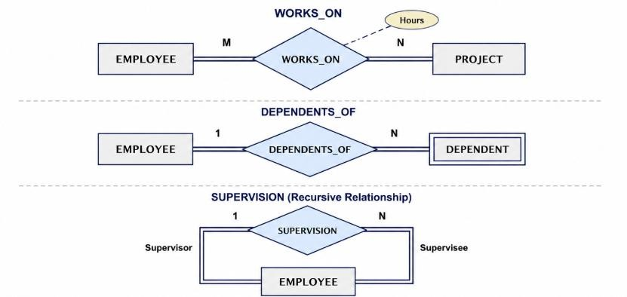
Contd..

Slide 47
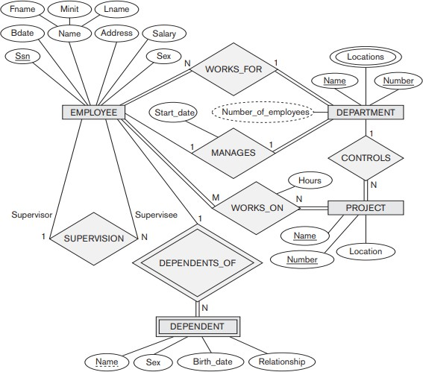
Complete ER Diagram

Slide 48
Normalization
After an ER model is converted into relational tables, the resulting tables may contain redundant data.
Redundancy can lead to several problems during data insertion, updation, and
deletion.
Normalization is the process of organizing data into well-structured relations to:
Reduce data redundancy
Improve data consistency
Eliminate modification anomalies
Improve data integrity

Slide 49
Why is Normalization Required?
Suppose the COMPANY database is stored in a single relation as shown
below.
EmpSSN | EmpName | DeptNo | DeptName | DeptLocation | MgrSSN
123456789 | John Smith | 5 | Research | Houston | 333445555
453453453 | Joyce English | 5 | Research | Houston | 333445555
666884444 | Ramesh Narayan | 4 | Administration | Stafford | 987654321
987987987 | Ahmad Jabbar | 4 | Administration | Stafford | 987654321
The department information is repeated for every employee belonging to the same department.
This redundancy increases storage requirements and may lead to:
Update Anomalies
Insertion Anomalies
Deletion Anomalies

Slide 50
Normal Forms
Normalization is achieved by transforming a relation into a sequence of well-
structured relations known as Normal Forms.
Each normal form addresses a specific type of redundancy and dependency.
Normal Form | Objective
First Normal Form (1NF) | Eliminate repeating groups and ensure atomic attribute values.
Second Normal Form (2NF) | Eliminate partial functional dependencies.
Third Normal Form (3NF) | Eliminate transitive dependencies.

Slide 51
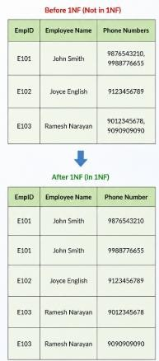
First Normal Form
A relation is in First Normal Form (1NF) if:
Every attribute contains atomic (indivisible) values.
There are no repeating groups or multivalued
attributes.
Each row is uniquely identifiable using a primary key.
Converting a relation to 1NF involves ensuring that each cell contains only a single value.

Slide 52
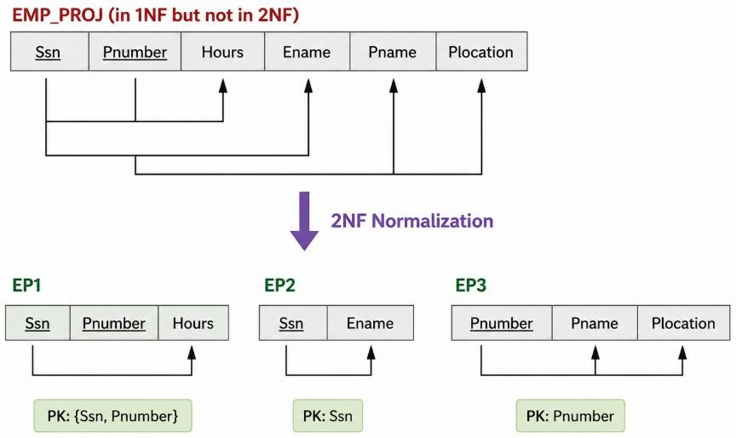
Second Normal Form
A relation is in Second Normal Form (2NF) if:
It is already in First Normal Form (1NF).
Every non-prime attribute is fully functionally dependent on the entire candidate key.
There are no partial functional dependencies. 2NF is relevant only when a candidate key is composite (consists of more than one attribute).

Slide 53
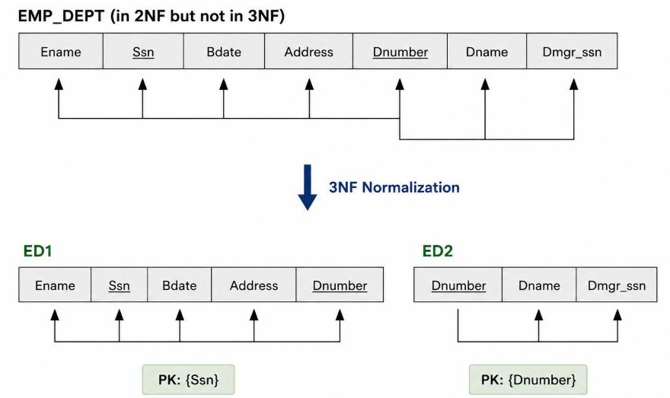
Third Normal Form
A relation is in Third Normal Form (3NF) if:
It is already in Second Normal Form (2NF).
There are no transitive functional dependencies.
Every non-prime attribute depends only on a candidate key, and not on another non-prime attribute.
A transitive dependency occurs when a non-prime attribute depends on another non-prime attribute instead of depending directly on a candidate key.

Slide 54
Thank You

